Slide 1

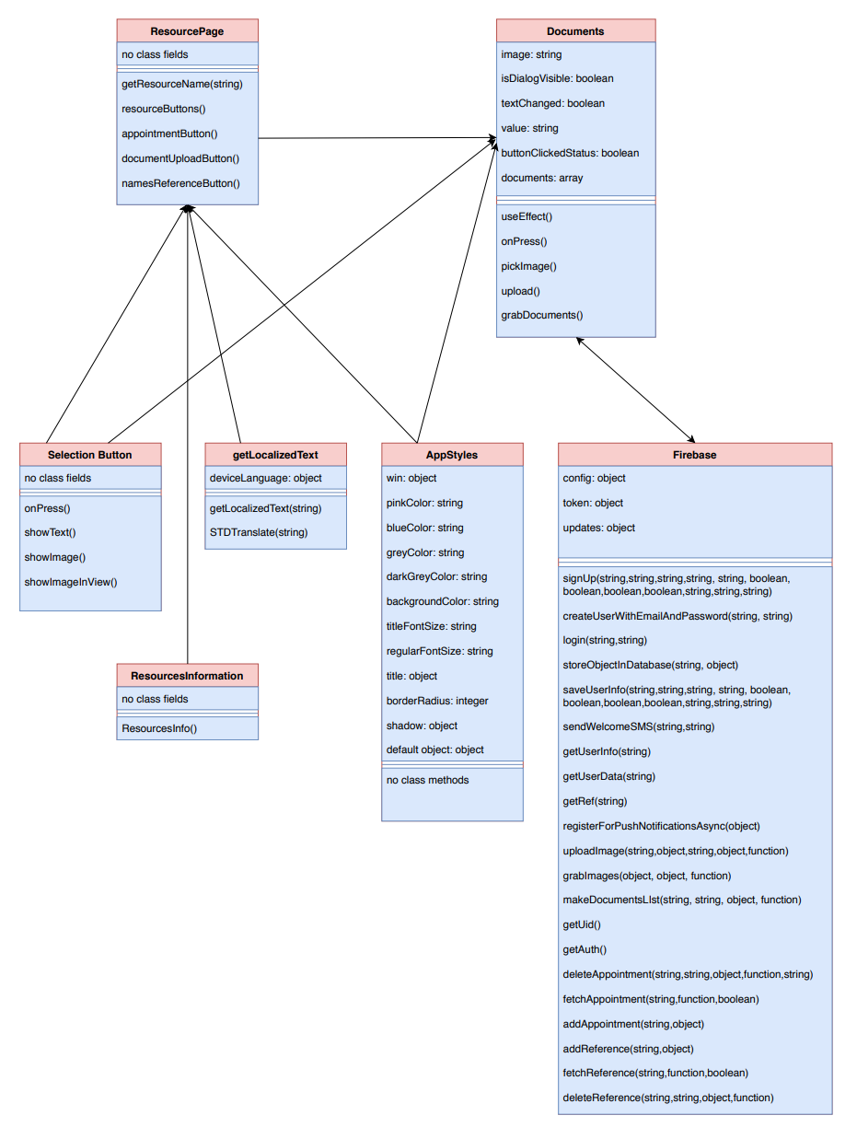
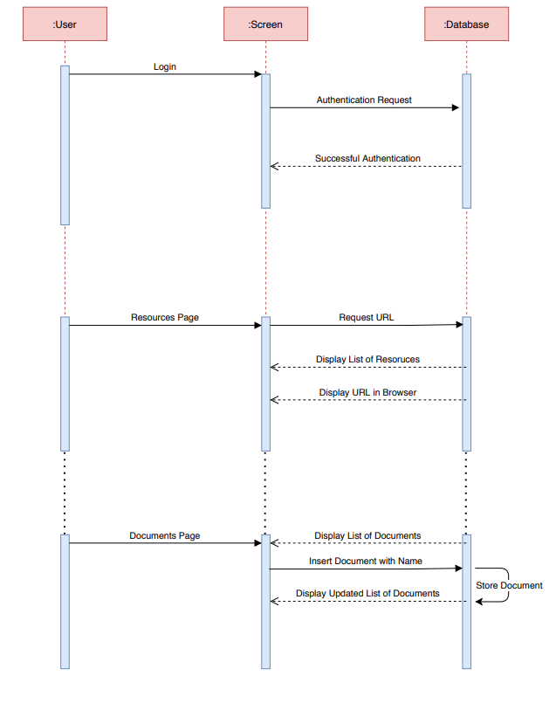



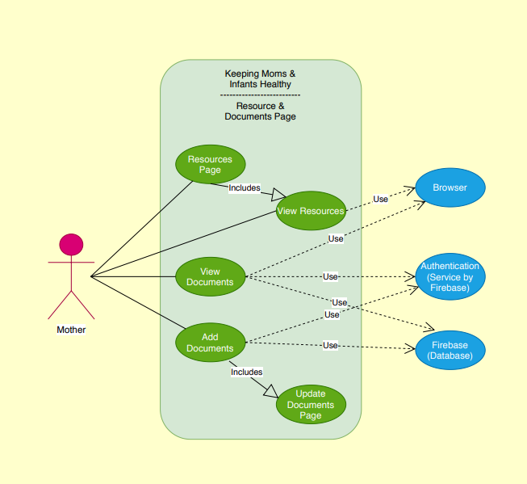




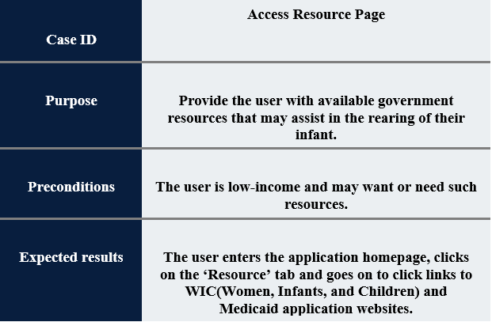
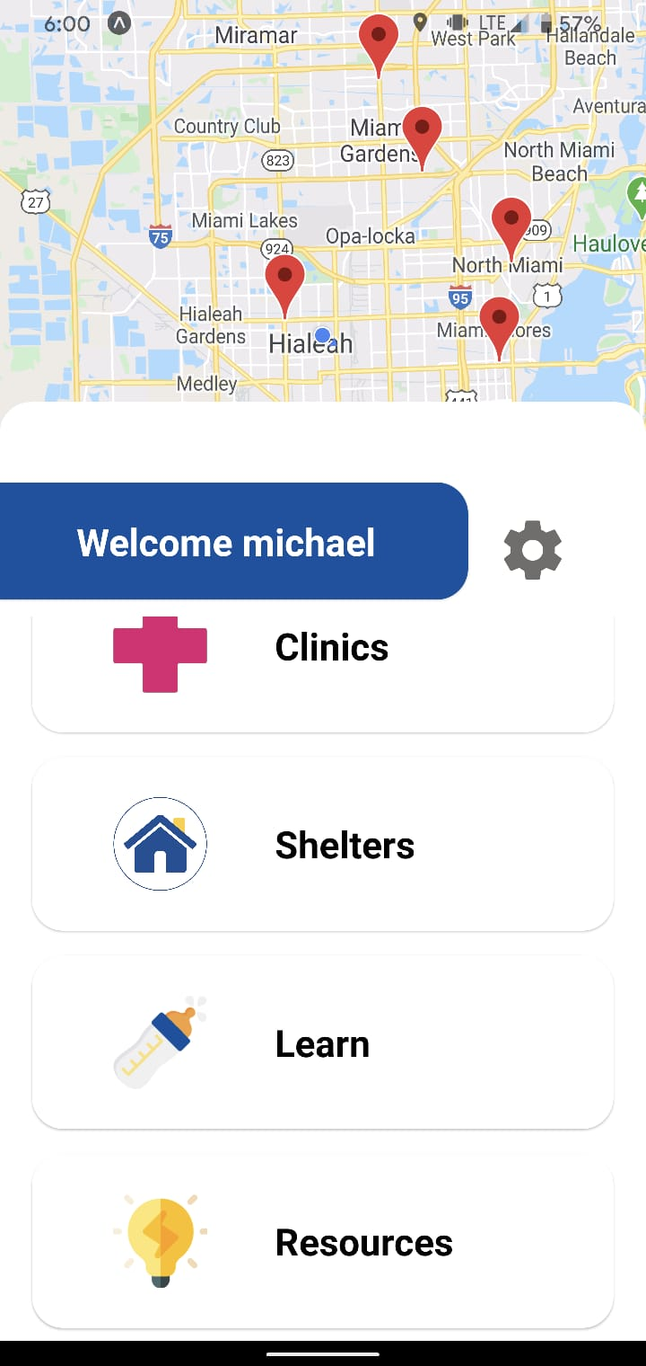
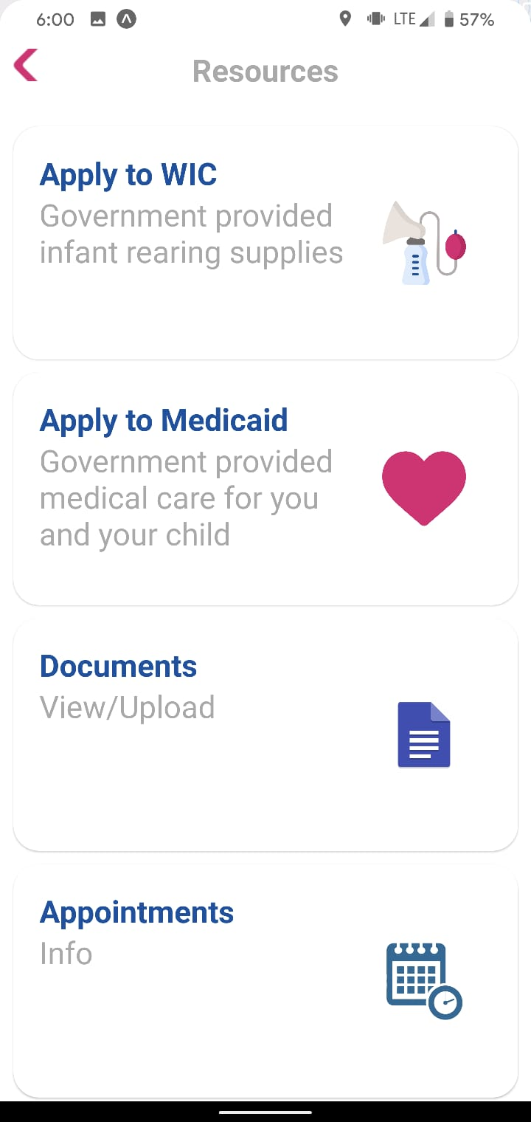
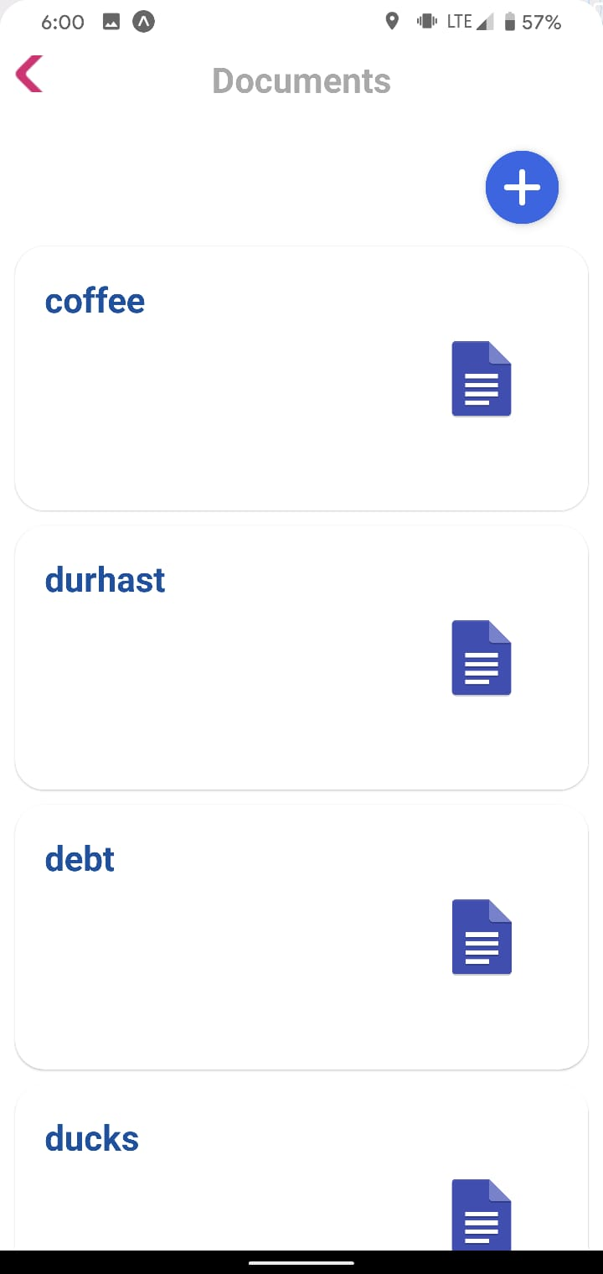
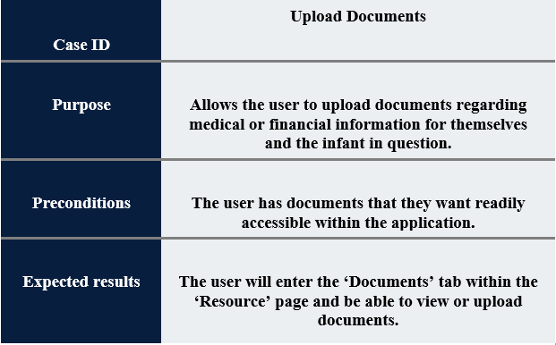
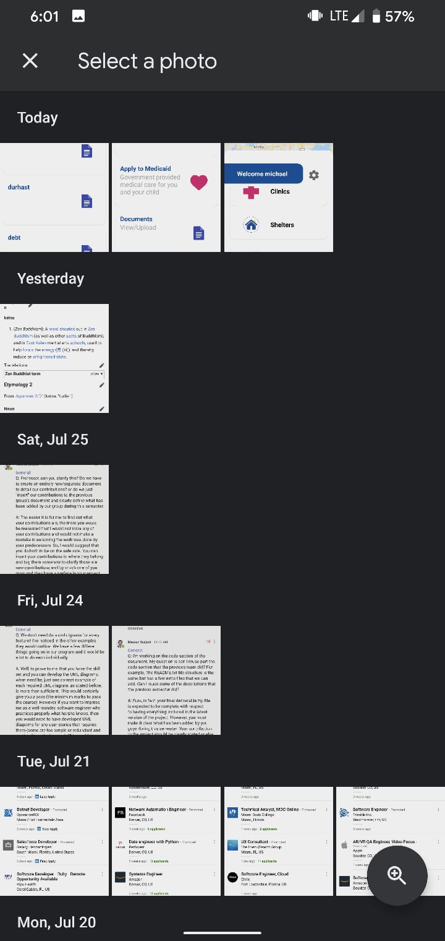
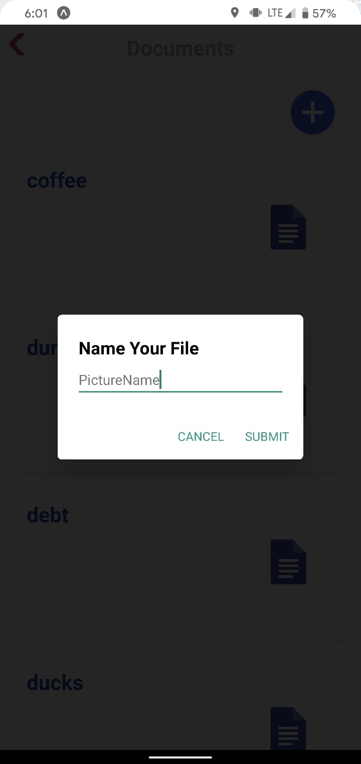
School of Computing & Information Sciences
Summer 2020 Senior Design Project
Keeping Moms & Infants Healthy
Student: Michael Llanes, Florida International University
Mentor: Dr.Jean Hannan,Florida International University
Instructor: Dr. Masoud Sadjadi, Florida International University
Problem
Current System
Requirements
Many low-income parents are unaware of the resources and information relevant to the rearing of their infant. What clinics they can attend, what illnesses and medical care they should be aware of, and the low cost of these resources should not be unattainable for parents.
While the UI elements and styling of the application were set up, a lot of intended functionality was not in place.
The application had messy code that depended on class inheritance and passing ‘props.’
The intended functionality of the application was very shallow. More robust features such as document uploading are necessary for the validity of its function.
Ability to upload documents relevant to their and their infant’s medical information.
Ability to view information about clinics as well as shelters while also being able to sort them through services provided and distance.
Ability to provide the user with information regarding the medical and financial care a low-income parent might require.
System Design
Object Design
Implementation
A simple, model-view-controller based mobile application that alerts the user, presumably parents, of actions required for their infant as well as allows the user to access information regarding medical services that are readily available to them. The application will store documents in a database and uniquely allow the user to access their documents. Links provided by the app will be opened in the default browser of the user.
Verification
Screenshots
Summary
By guiding low-income parents to information relevant to them and their child whether it be clinics they can attend or government resources they may access, their child-rearing process is facilitated and simplified within a centralized application.
Being able to store relevant documents and access them upon use of the app may promote making use of their medical care and improve their daily lives.
Acknowledgement
The material presented in this poster is based upon the work supported by FIU and the Architecture Department. I thank Dr.Jean Hannan and Dr. Masoud Sadjadi for assistance, cooperation and mentorship that I received throughout this process. I would also like to thank my teammates Amin, Noe, and Gabriel for the great help and teamwork they provided
Notes:
‹#›

